Slide 1

Palm Calculus Part 2 Theory
Jean-Yves Le Boudec 2021

Slide 2
Contents
Palm Calculus
Application to Simulation
Perfect Simulation
PASTA

Slide 3
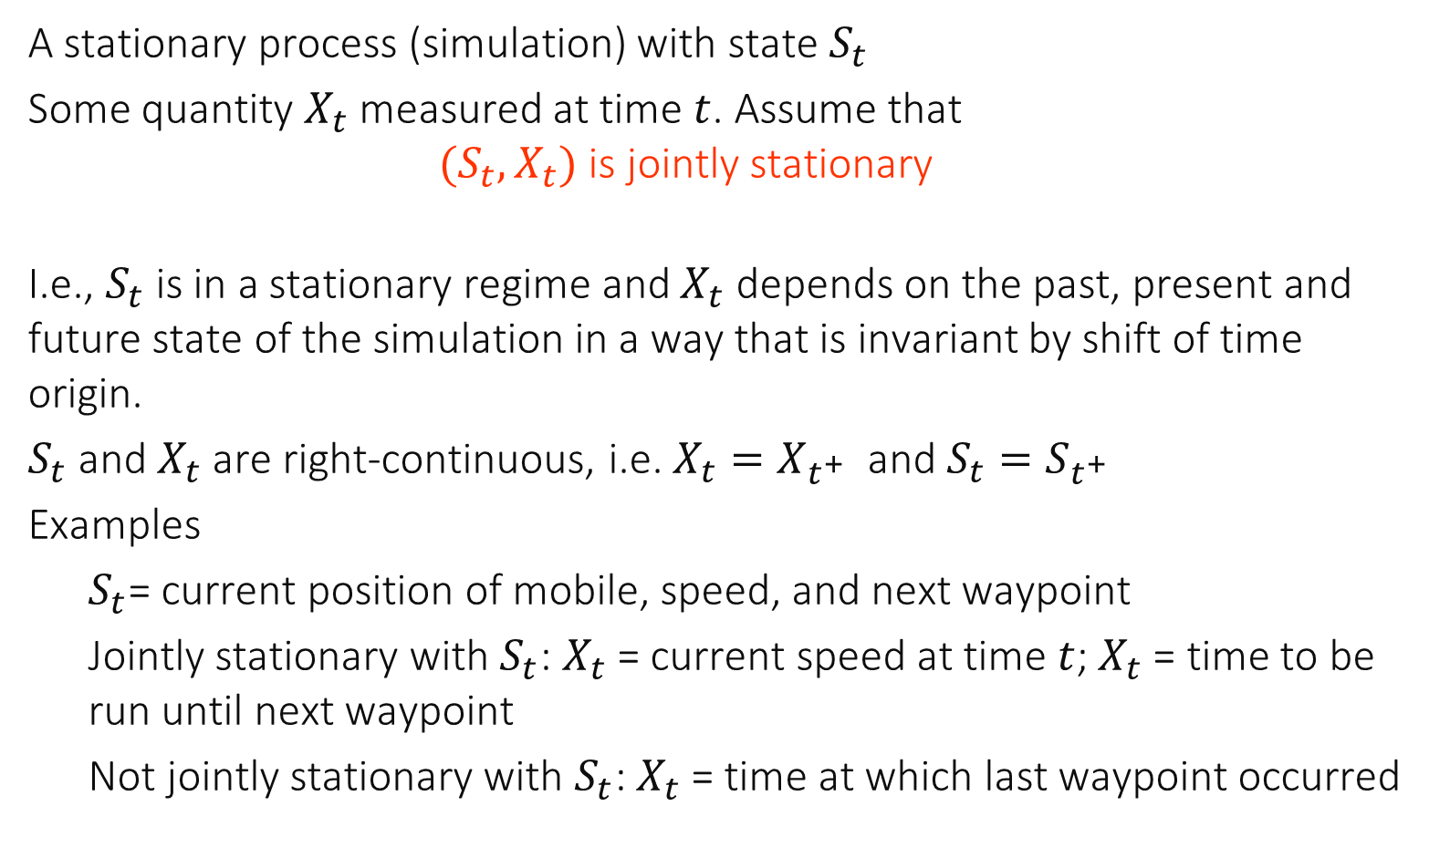
1. Palm Calculus : Framework
A stationary process (simulation) with state $S_{t}$
Some quantity $X_{t}$ measured at time $t$. Assume that $(S_{t}, X_{t})$ is jointly stationary
I.e., $S_{t}$ is in a stationary regime and $X_{t}$ depends on the past, present and future state of the simulation in a way that is invariant by shift of time origin.
$S_{t}$ and $X_{t}$ are right-continuous, i.e. $X_{t}=X_{t^{+}}$ and $S_{t}=S_{t^{+}}$
Examples
$S_{t}$= current position of mobile, speed, and next waypoint
Jointly stationary with $S_{t}$: $X_{t}$ = current speed at time $t$; $X_{t}$ = time to be run until next waypoint
Not jointly stationary with $S_{t}$: $X_{t}$ = time at which last waypoint occurred

Slide 4
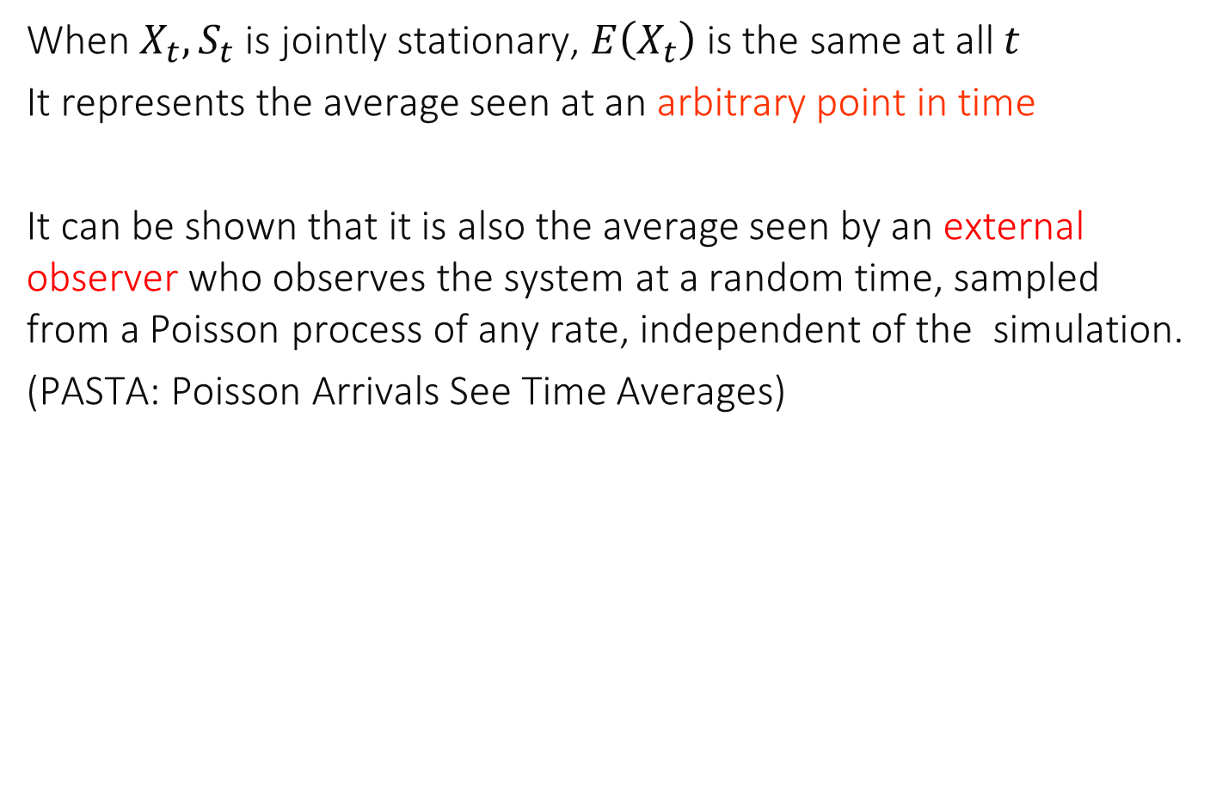
Arbitrary Point in Time
When $X_{t},S_{t}$ is jointly stationary, $E\left(X_{t}\right)$ is the same at all $t$
It represents the average seen at an arbitrary point in time
It can be shown that it is also the average seen by an external observer who observes the system at a random time, sampled from a Poisson process of any rate, independent of the simulation.
(PASTA: Poisson Arrivals See Time Averages)

Slide 5
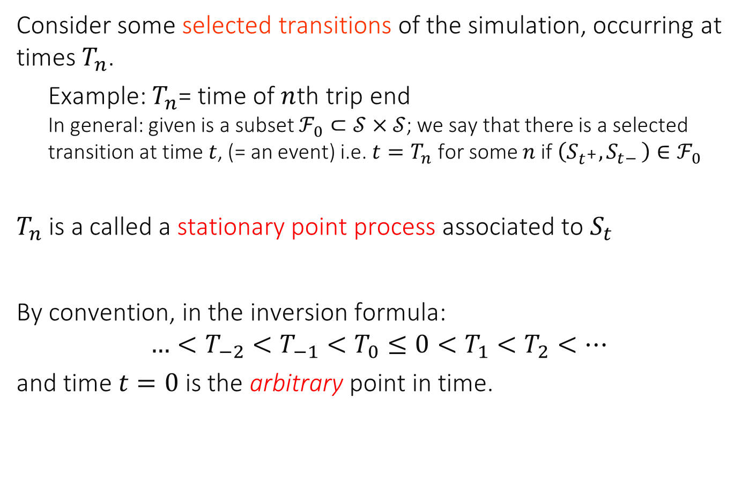
Stationary Point Process
Consider some selected transitions of the simulation, occurring at times $T_{n}$.
Example: $T_{n}$= time of $n$th trip end In general: given is a subset $ℱ_{0}⊂𝒮×𝒮$; we say that there is a selected transition at time $t$, (= an event) i.e. $t=T_{n}$ for some $n$if $\left(S_{t^{+}},S_{t− }\right)∈ℱ_{0}$
$T_{n}$ is a called a stationary point process associated to $S_{t}$
By convention, in the inversion formula:
$$…<T_{−2}<T_{−1}<T_{0}≤0<T_{1}<T_{2}<…$$
and time $t=0$ is the arbitrary point in time.

Slide 6
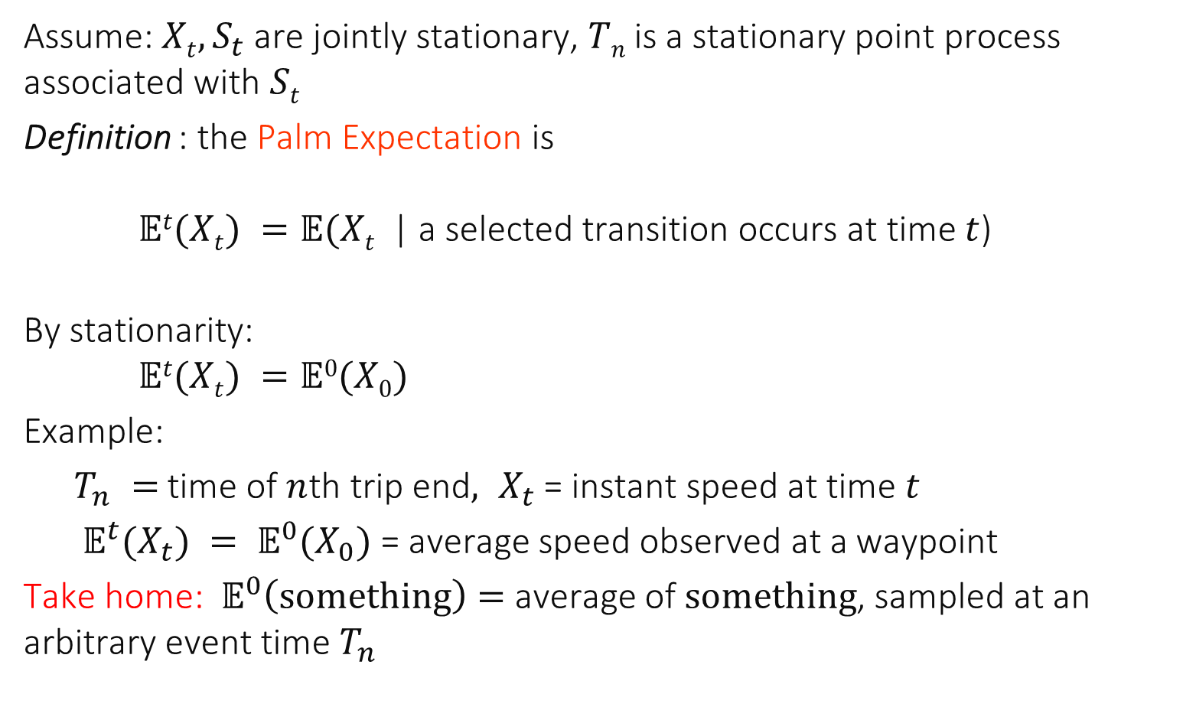
Palm Expectation
Assume: $Xt, S_{t}$are jointly stationary, $Tn$is a stationary point process associated with $St$
Definition : the Palm Expectation is $𝔼t(Xt) =𝔼(Xt$ | a selected transition occurs at time $t$)
By stationarity: $𝔼t(Xt) =𝔼0(X0)$
Example:
$T_{n} =$time of $n$th trip end$, X_{t}$= instant speed at time $t$
$𝔼^{t}(X_{t}) = 𝔼^{0}(X_{0})$= average speed observed at a waypoint
Take home: $𝔼^{0}\left(something\right)=$ average of $something$, sampled at an arbitrary event time $T_{n}$

Slide 7
E(X_{t}) = E(X₀) expresses the time average viewpoint.
E^{t}(X_{t}) = E⁰(X₀) expresses the event average viewpoint.
Example for random waypoint:
T_{n} = time of n^{th} trip end, X_{t} = instant speed at time t
E^{t}(X_{t}) = E⁰(X₀) = average speed observed at trip end
E(X_{t})=E(X₀) = average speed observed at an arbitrary point in time
X_{n+1}
X_{n}

Slide 8
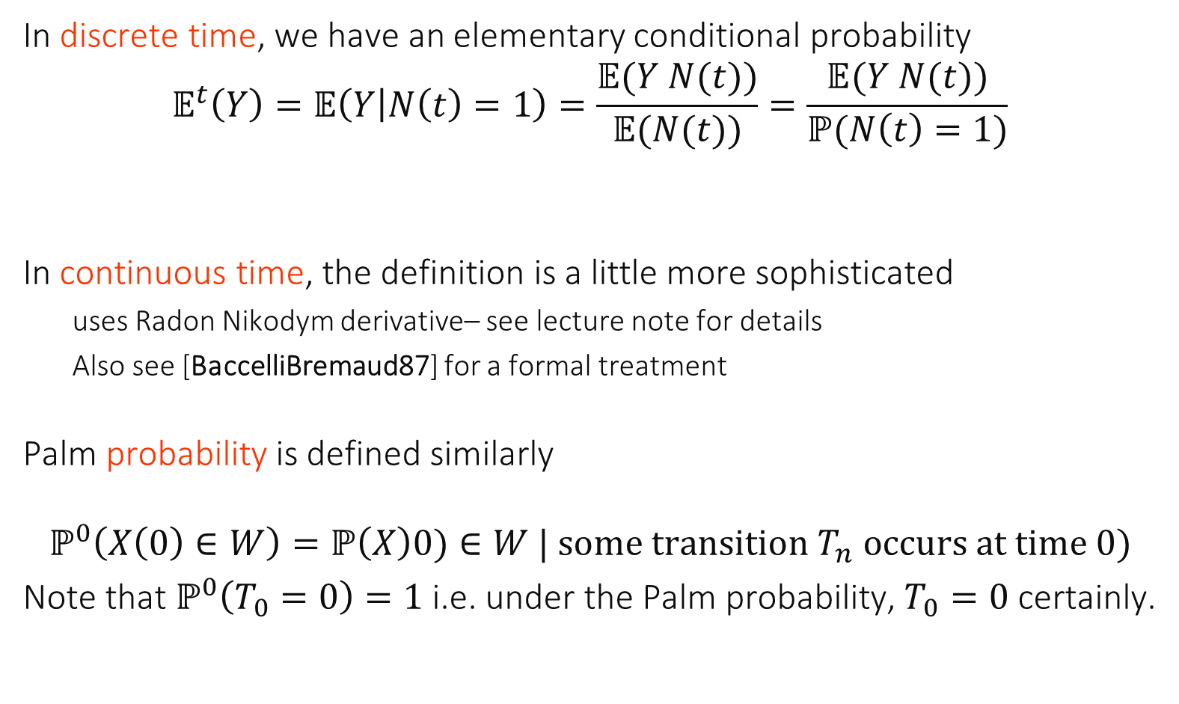
Formal Definition
In discrete time, we have an elementary conditional probability
$$𝔼^{t}\left(Y\right)=𝔼\left(Y | N\left(t\right)=1\right)=\frac{𝔼(Y N(t))}{𝔼(N(t))}=\frac{𝔼(Y N(t))}{ℙ(N\left(t\right)=1)}$$
In continuous time, the definition is a little more sophisticated
uses Radon Nikodym derivative– see lecture note for details
Also see [BaccelliBremaud87] for a formal treatment
Palm probability is defined similarly
$$ℙ^{0}\left(X\left(0\right)∈W\right)=ℙ\left(X\right)0)∈W | some transition T_{n} occurs at time 0)$$
Note that $ℙ^{0}\left(T_{0}=0\right)=1$ i.e. under the Palm probability, $T_{0}=0$ certainly.

Slide 9
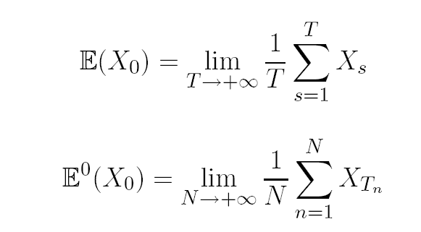
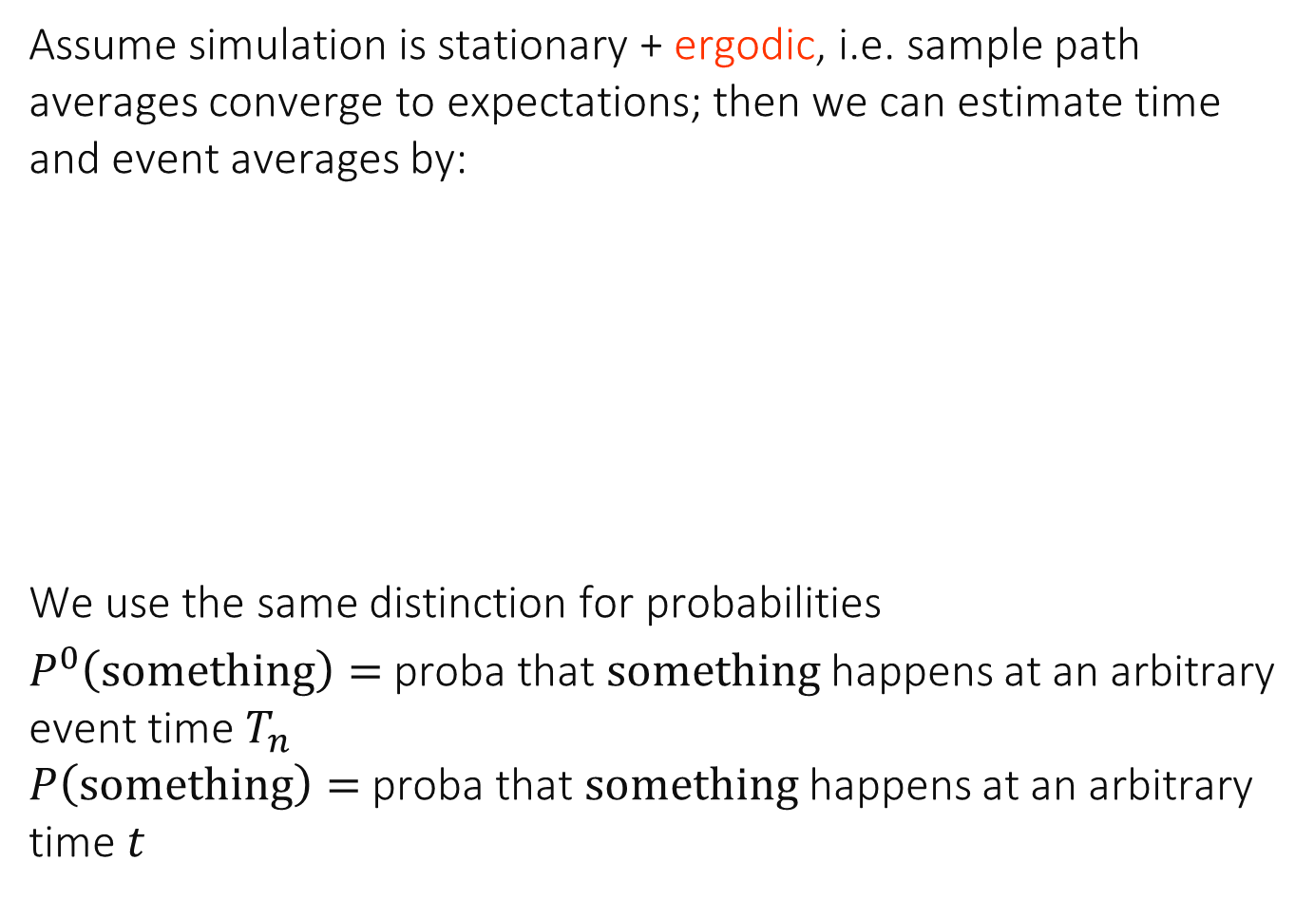
Ergodic Interpretation = Large Time Heuristic
Assume simulation is stationary + ergodic, i.e. sample path averages converge to expectations; then we can estimate time and event averages by:
We use the same distinction for probabilities
$P^{0}\left(something\right)=$ proba that $something$happens at an arbitrary event time $T_{n}$ $P\left(something\right)=$ proba that $something$happens at an arbitrary time $t$

Slide 10
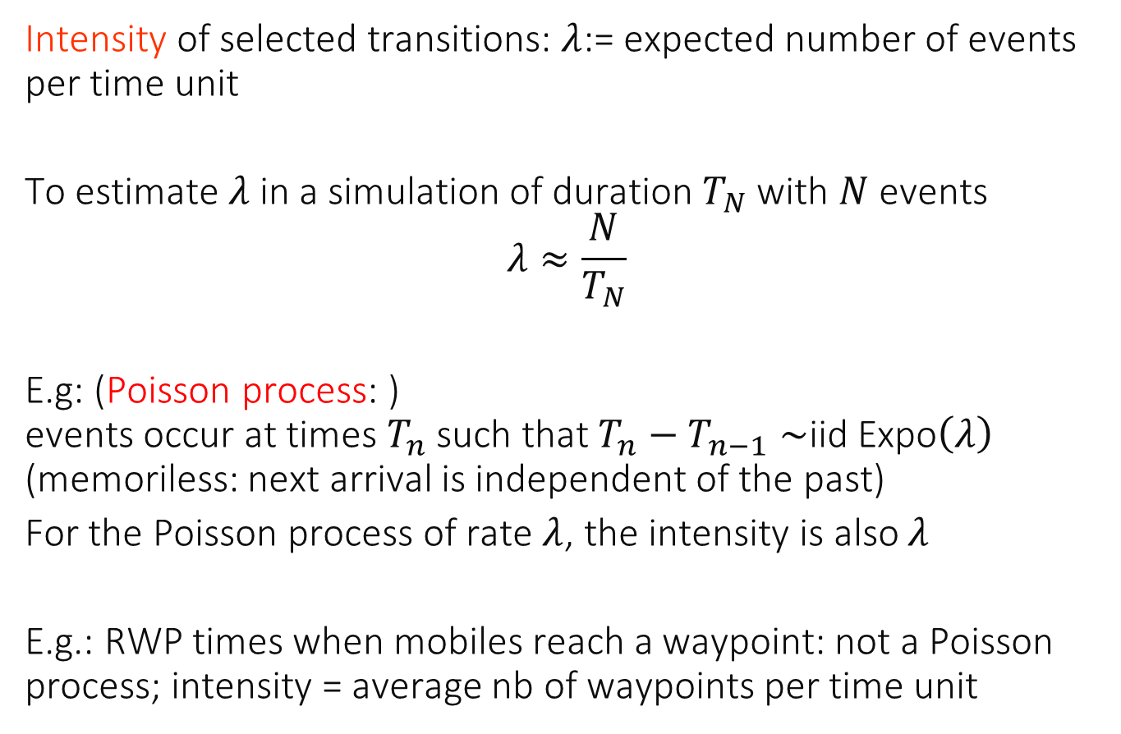
Intensity of a Stationary Point Process
Intensity of selected transitions: $λ$:= expected number of events per time unit
To estimate $λ$in a simulation of duration $T_{N}$ with $N$events
$$λ≈\frac{N}{T_{N}}$$
E.g: (Poisson process: ) events occur at times $T_{n}$ such that $T_{n}−T_{n−1}∼$iid Expo$\left(λ\right)$ (memoriless: next arrival is independent of the past)
For the Poisson process of rate $λ$, the intensity is also $λ$
E.g.: RWP times when mobiles reach a waypoint: not a Poisson process; intensity = average nb of waypoints per time unit

Slide 11
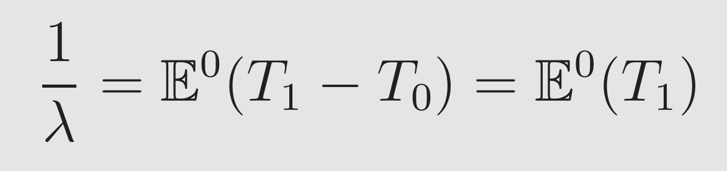
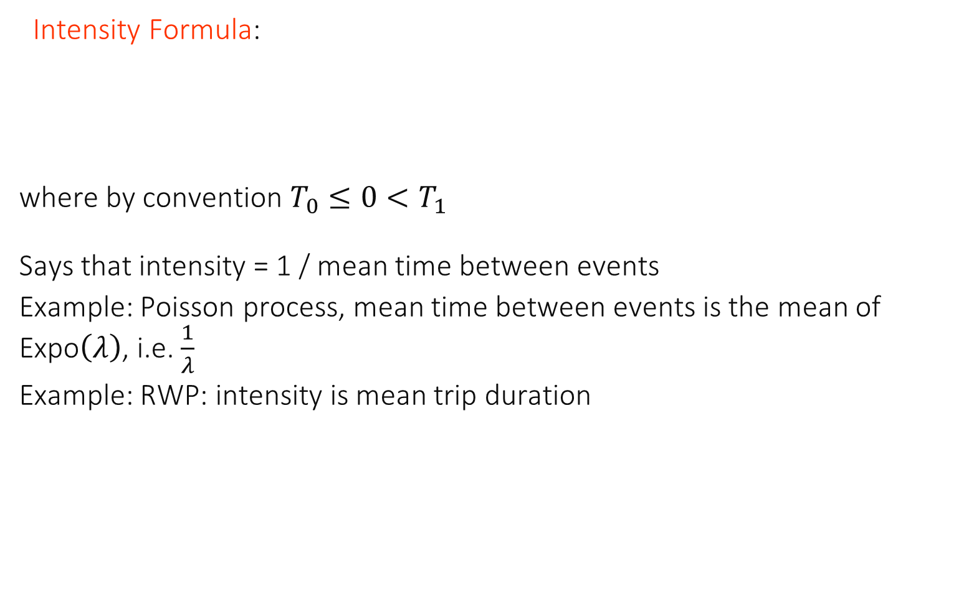
Palm Calculus Formula #1
Intensity Formula: where by convention $T_{0}≤0<T_{1}$
Says that intensity = 1 / mean time between events
Example: Poisson process, mean time between events is the mean of Expo$\left(λ\right)$, i.e. $\frac{1}{λ}$
Example: RWP: intensity is mean trip duration

Slide 12

The interval between 2 buses is $∼U\left(15,25\right)$minutes
There are 2 buses in average per hour
There are 3 buses in average per hour
There are 4 buses in average per hour
None of the above
I don’t know

Slide 13
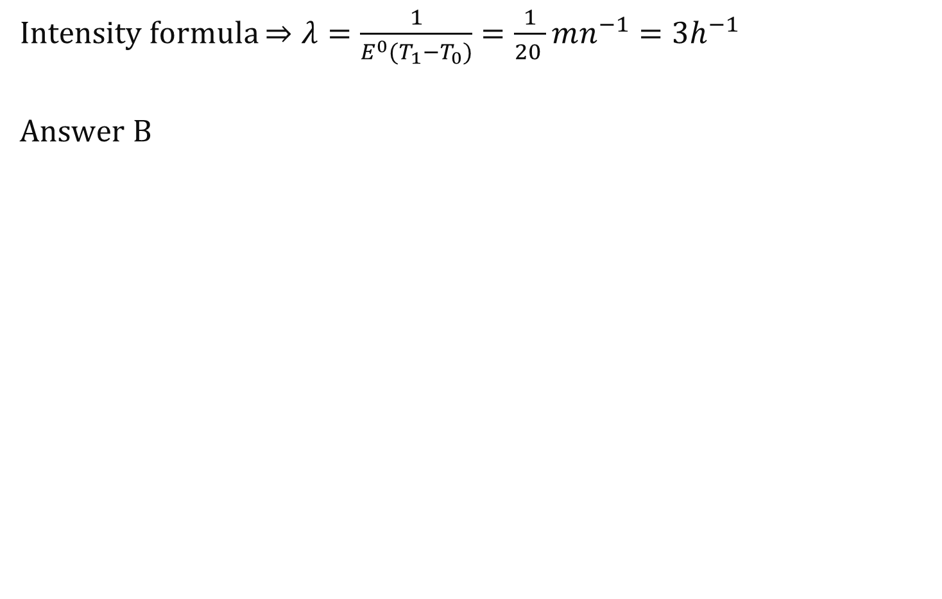
Solution
Intensity formula $⇒λ=\frac{1}{E^{0}(T_{1}−T_{0})}=\frac{1}{20 }mn^{−1}=3h^{−1}$
Answer B

Slide 14
The validity of the formula in the previous question requires that …
The arrival process is Poisson
The arrival process is stationary
The interarrival times are iid
None of the above
I don’t know

Slide 15
Solution
Answer B. Palm calculus requires only stationarity. Note that a Poisson process is stationary, as is a process with independent interarrival times.

Slide 16
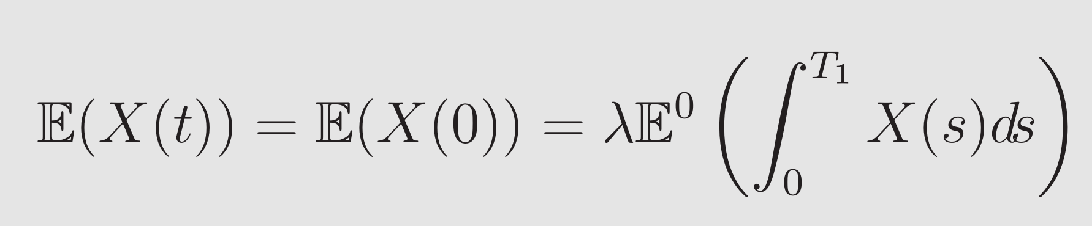
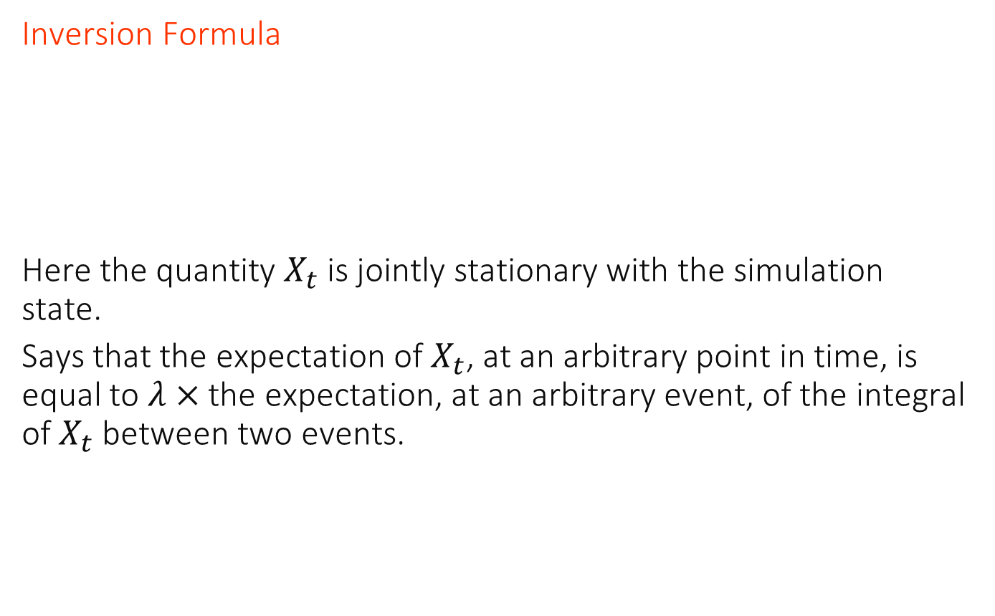
Palm Calculus Formula #2
Inversion Formula
Here the quantity $X_{t}$ is jointly stationary with the simulation state.
Says that the expectation of $X_{t}$, at an arbitrary point in time, is equal to $λ×$ the expectation, at an arbitrary event, of the integral of $X_{t}$ between two events.

Slide 17
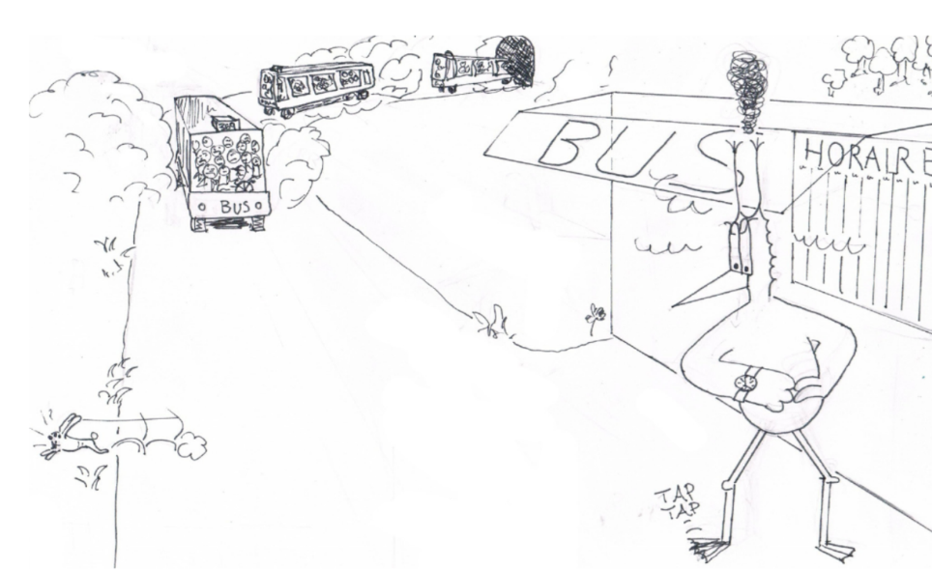
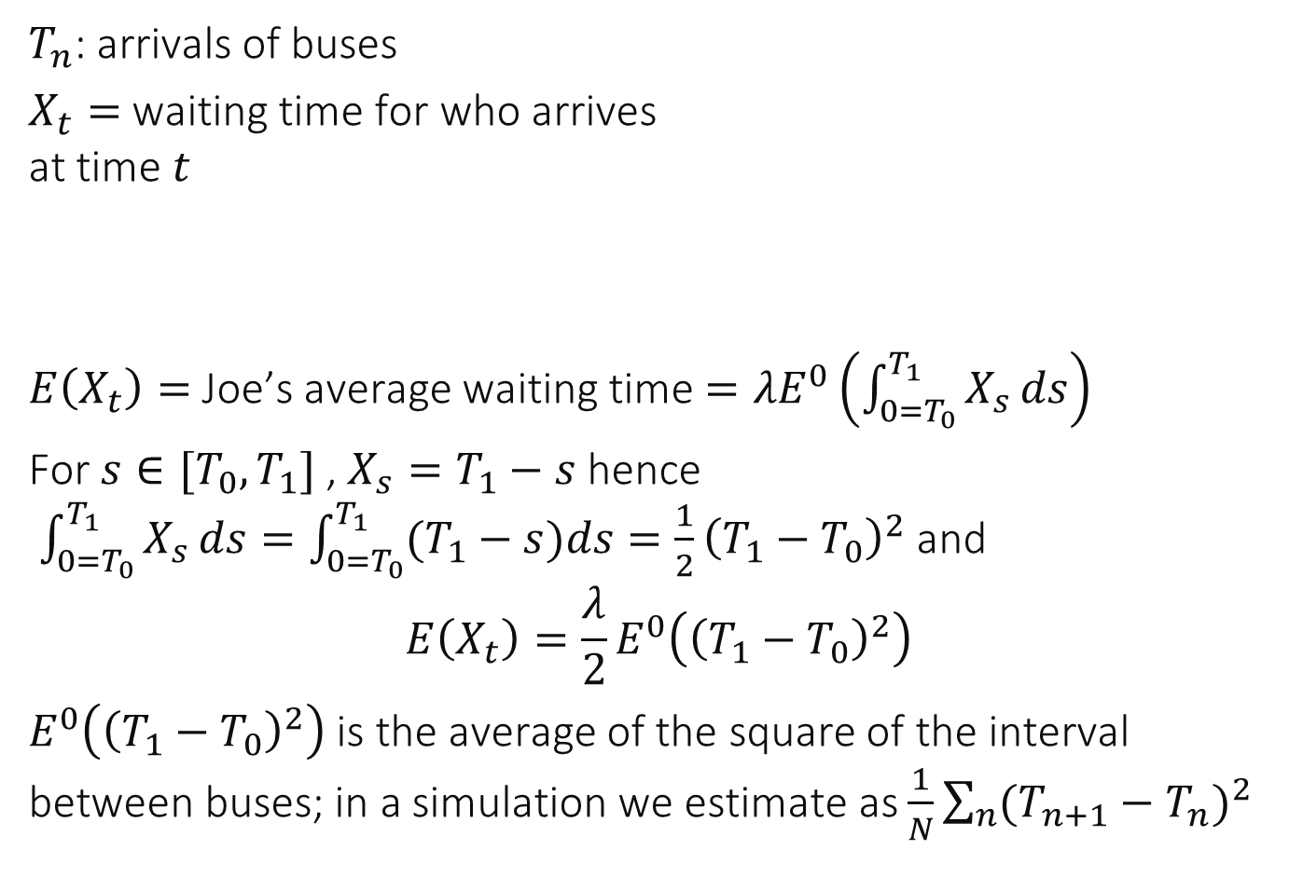
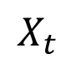
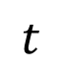
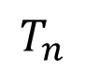
Example: Joe’s Waiting Time
$T_{n}$: arrivals of buses
$X_{t}=$ waiting time for who arrives at time $t$
$E\left(X_{t}\right)=$Joe’s average waiting time $=λE^{0}\left(\int_{0=T_{0}}^{T_{1}}{X_{s}}ds\right)$
For $s∈[T_{0},T_{1}]$ , $X_{s}=T_{1}−s$ hence $\int_{0=T_{0}}^{T_{1}}{X_{s}}ds=\int_{0=T_{0}}^{T_{1}}{(T_{1}}−s)ds{=\frac{1}{2}\left(T_{1}−T_{0}\right)}^{2}$and
$$E\left(X_{t}\right)={\frac{λ}{2}E}^{0}\left({\left(T_{1}−T_{0}\right)}^{2}\right)$$
$E^{0}\left({\left(T_{1}−T_{0}\right)}^{2}\right)$ is the average of the square of the interval between buses; in a simulation we estimate as $\frac{1}{N}\sum_{n}{{(T_{n+1}−T_{n})}^{2}}$
$$X_{t}$$
$$T_{n}$$
$$t$$

Slide 18

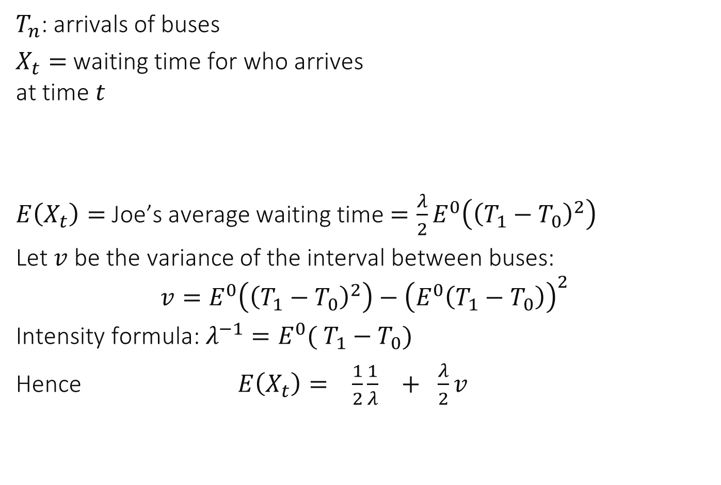
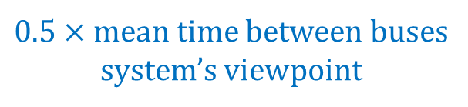

$T_{n}$: arrivals of buses
$X_{t}=$ waiting time for who arrives at time $t$
$E\left(X_{t}\right)=$Joe’s average waiting time $={\frac{λ}{2}E}^{0}\left({\left(T_{1}−T_{0}\right)}^{2}\right)$
Let $v$ be the variance of the interval between buses:
$$v=E^{0}\left({\left(T_{1}−T_{0}\right)}^{2}\right)−{\left(E^{0}\left(T_{1}−T_{0}\right)\right)}^{2}$$
Intensity formula: $λ^{−1}=E^{0}( T_{1}−T_{0})$
Hence $E\left(X_{t}\right)= \frac{1}{2}\frac{1}{λ} + \frac{λ}{2}v$
$$X_{t}$$
$$T_{n}$$
$$t$$
$0.5×$mean time between buses system’s viewpoint
penalty due to variability

Slide 19
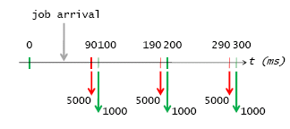
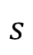
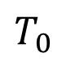
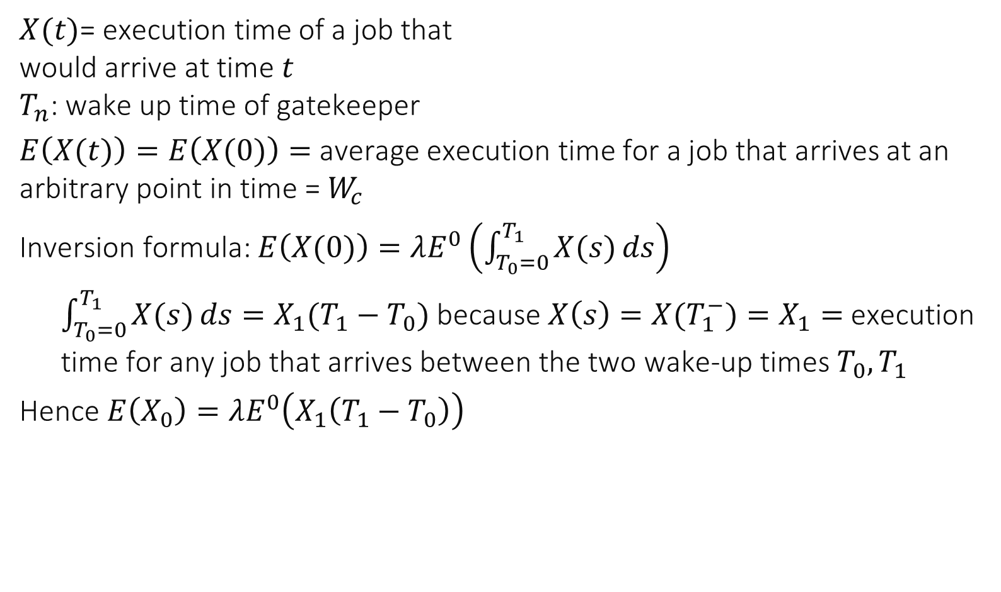
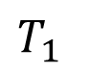
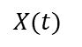
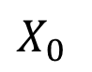
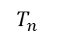
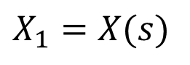
Example: Gatekeeper
$$T_{n}$$
$X(t)$= execution time of a job that would arrive at time $t$ $T_{n}$: wake up time of gatekeeper
$E\left(X(t)\right)=E\left(X(0)\right)=$ average execution time for a job that arrives at an arbitrary point in time =$W_{c}$
Inversion formula: $E\left(X(0)\right)=λE^{0}\left(\int_{T_{0}=0}^{T_{1}}{X(s)}ds\right)$
$\int_{T_{0}=0}^{T_{1}}{X(s)}ds=X_{1}(T_{1}−T_{0})$ because $X\left(s\right)=X(T_{1}^{−})=X_{1}=$execution time for any job that arrives between the two wake-up times $T_{0},T_{1}$
Hence $E\left(X_{0}\right)=λE^{0}\left(X_{1}\left(T_{1}−T_{0}\right)\right)$
$$X(t)$$
$$T_{0}$$
$$s$$
$$T_{1}$$
$$X_{0}$$
$$X_{1}=X(s)$$

Slide 20
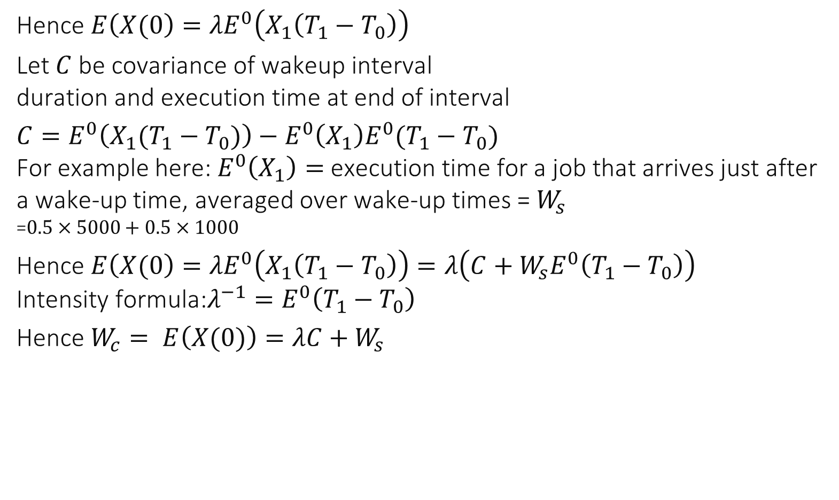
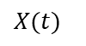
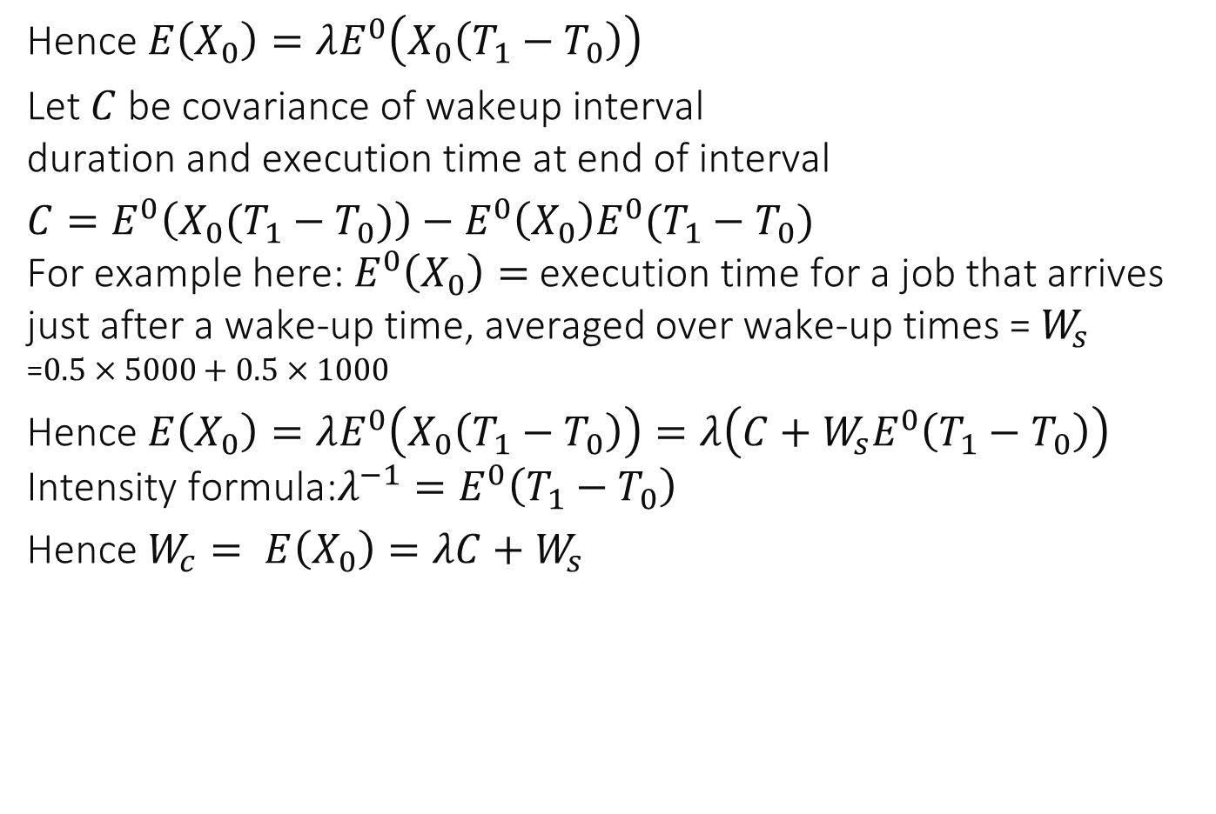
$$T_{n}$$
Hence $E\left(X(0\right)=λE^{0}\left(X_{1}\left(T_{1}−T_{0}\right)\right)$
Let $C$ be covariance of wakeup interval duration and execution time at end of interval
$C=E^{0}\left(X_{1}(T_{1}−T_{0})\right)−E^{0}\left(X_{1}\right)E^{0}(T_{1}−T_{0})$ For example here: $E^{0}\left(X_{1}\right)=$ execution time for a job that arrives just after a wake-up time, averaged over wake-up times =${ W}_{s}$ =$0.5×5000+0.5×1000$
Hence $E\left(X(0\right)=λE^{0}\left(X_{1}\left(T_{1}−T_{0}\right)\right)=λ\left(C+W_{s}E^{0}\left(T_{1}−T_{0}\right)\right)$ Intensity formula:$λ^{−1}=E^{0}\left(T_{1}−T_{0}\right)$
Hence $W_{c}= E\left(X(0)\right)=λC+W_{s}$
$$X(t)$$

Slide 21
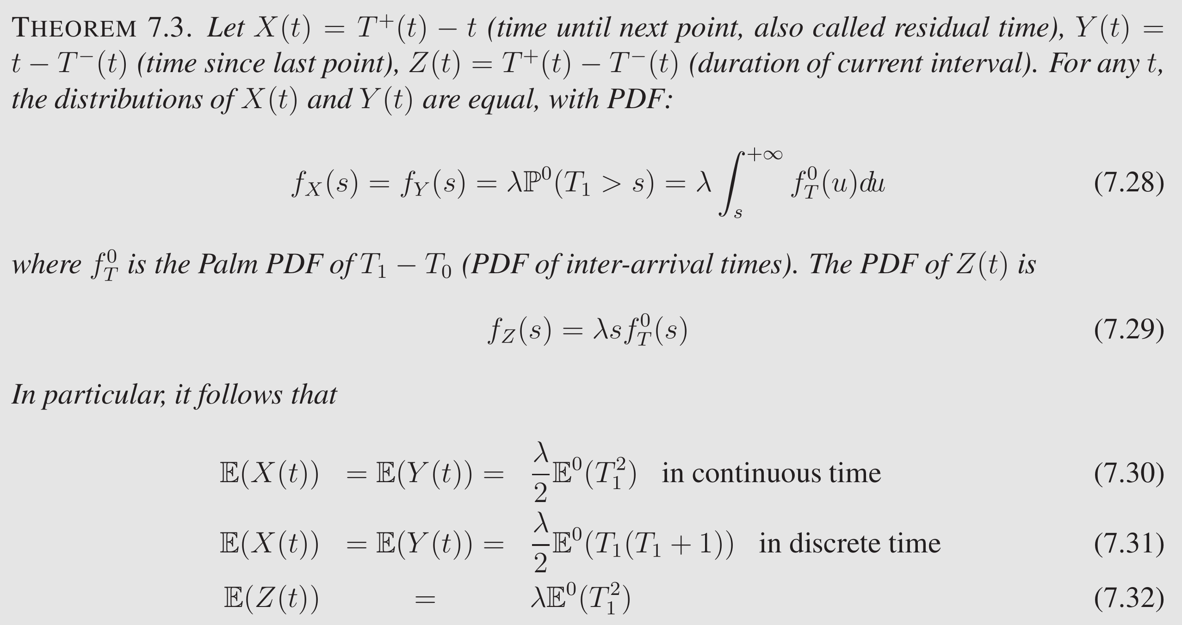
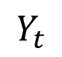
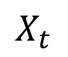
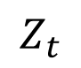
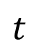
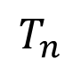
$$Z_{t}$$
$$X_{t}$$
$$T_{n}$$
$$t$$
$$Y_{t}$$

Slide 22
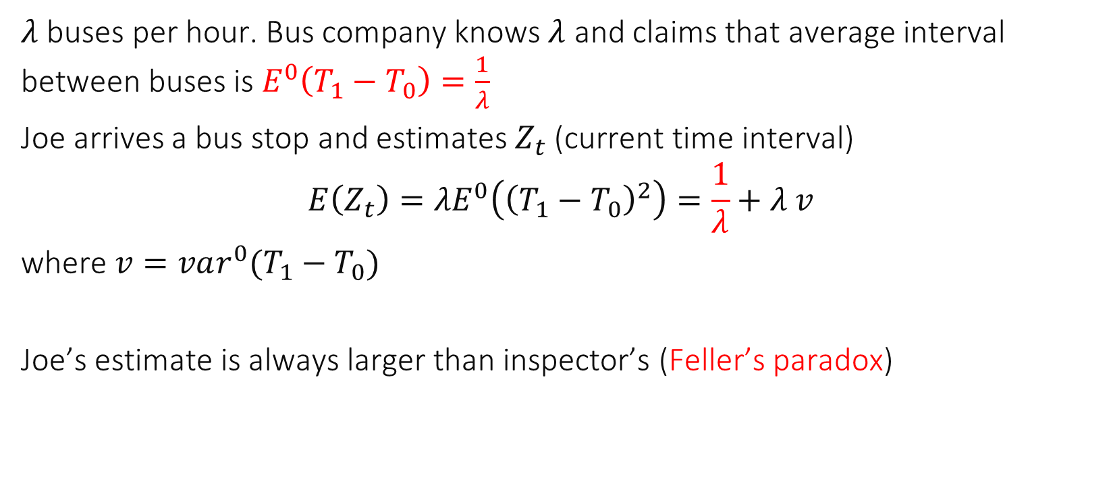
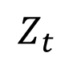
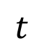
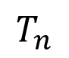
Feller’s Paradox
$$Z_{t}$$
$$T_{n}$$
$$t$$
$λ$ buses per hour. Bus company knows $λ$ and claims that average interval between buses is $E^{0}\left(T_{1}−T_{0}\right)=\frac{1}{λ}$
Joe arrives a bus stop and estimates $Z_{t}$ (current time interval)
$$E\left(Z_{t}\right)=λE^{0}\left({\left(T_{1}−T_{0}\right)}^{2}\right)=\frac{1}{λ}+λ v$$
where $v=var^{0}(T_{1}−T_{0})$
Joe’s estimate is always larger than inspector’s (Feller’s paradox)

Slide 23
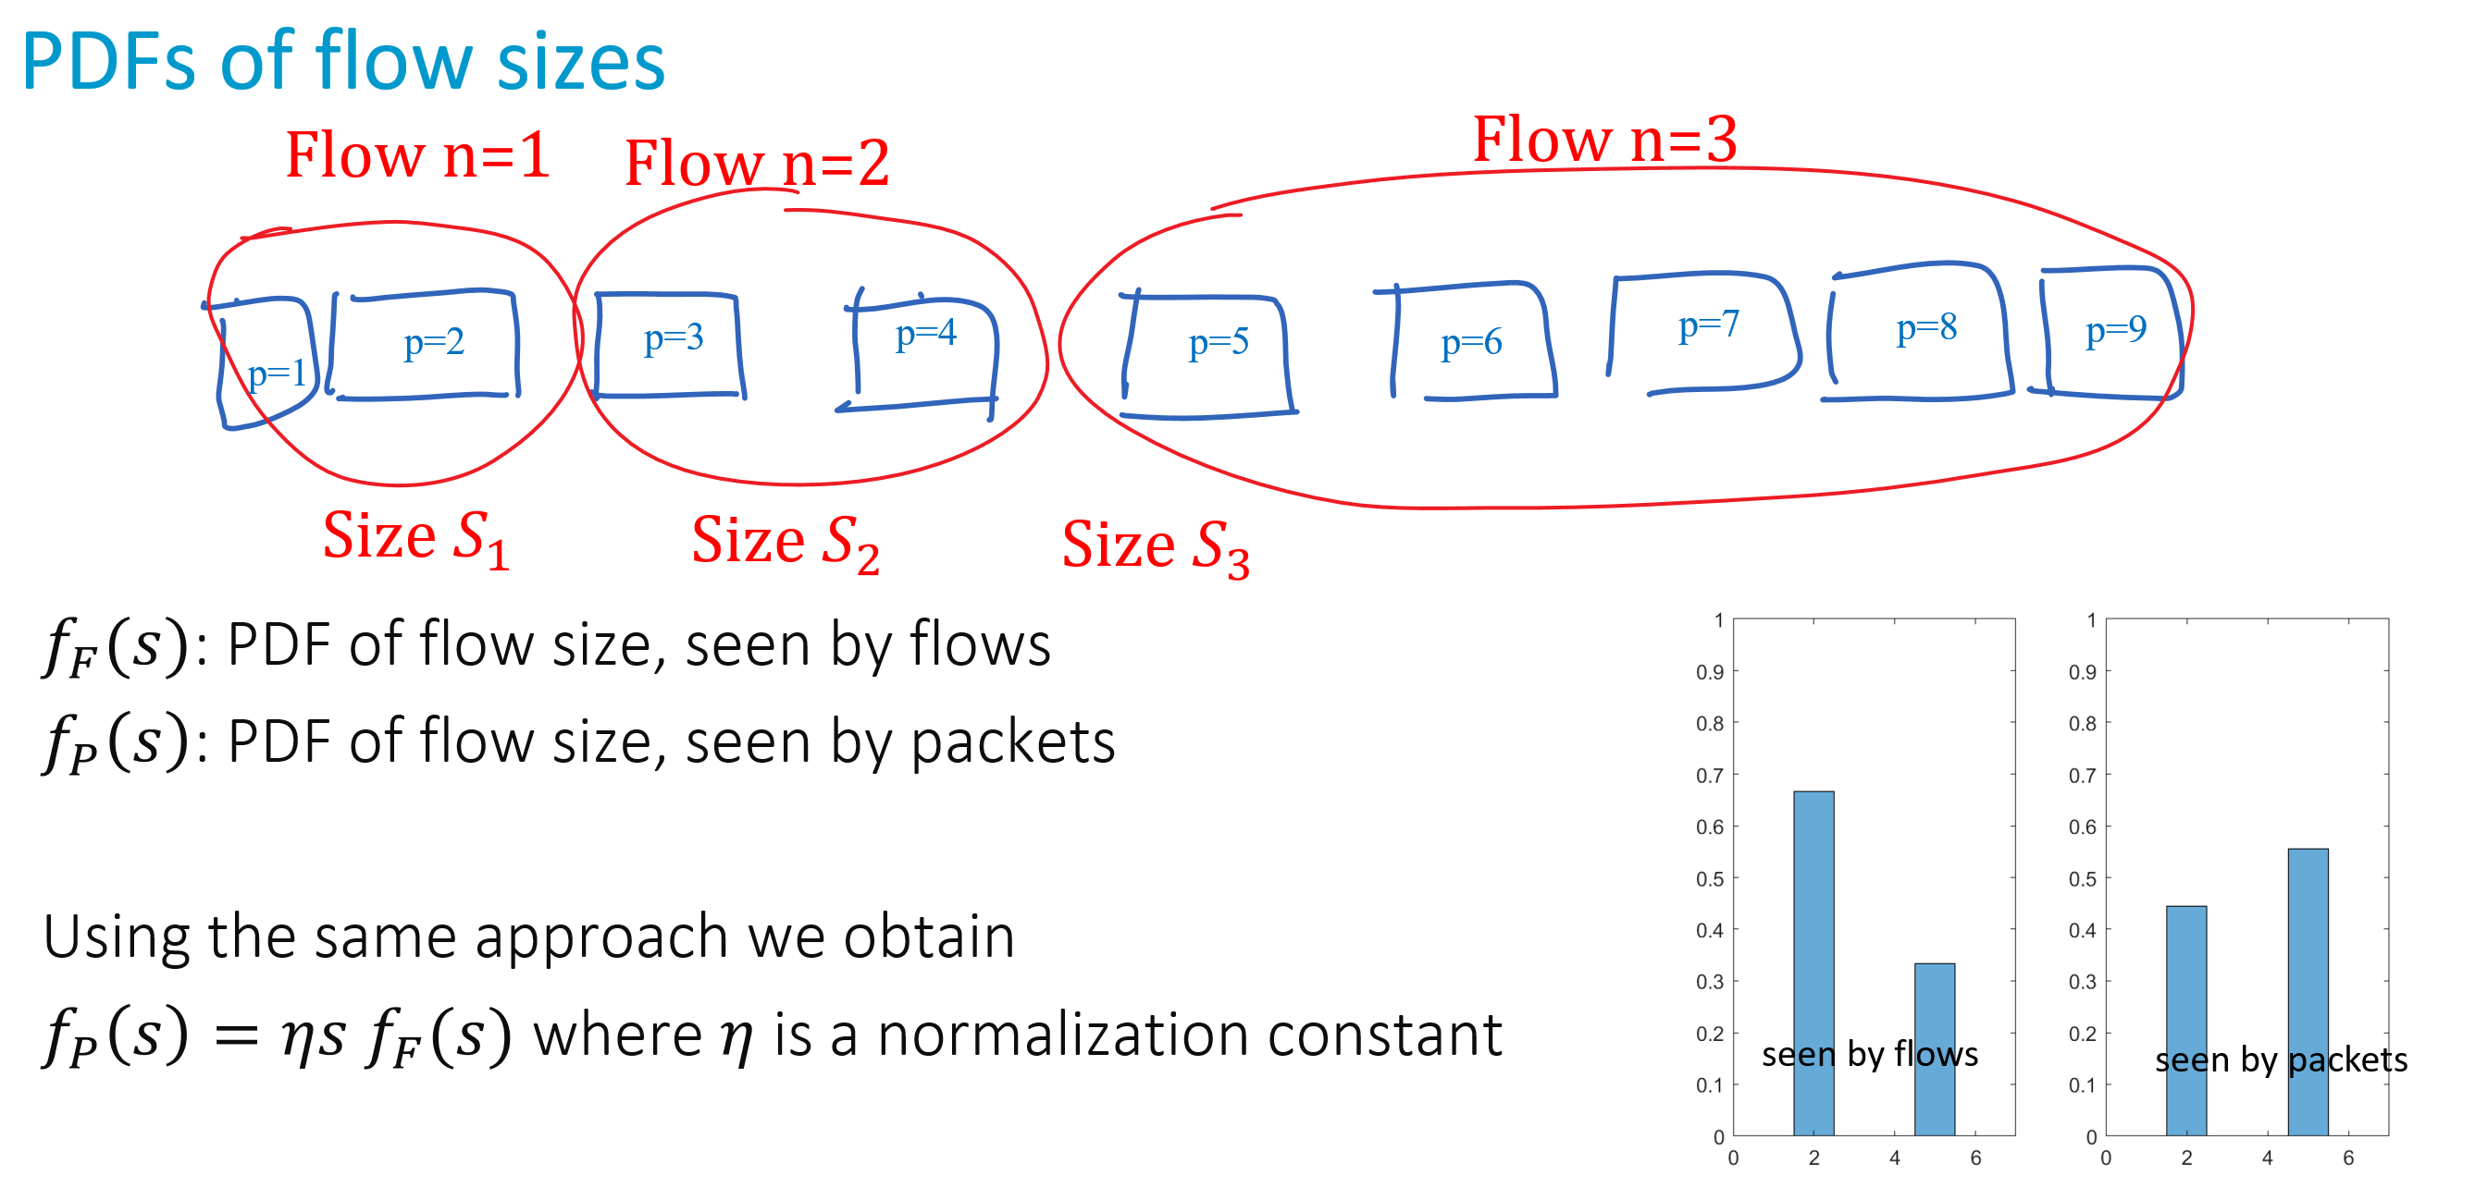
We encountered Feller’s Paradox Already

Slide 24
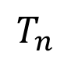
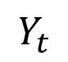
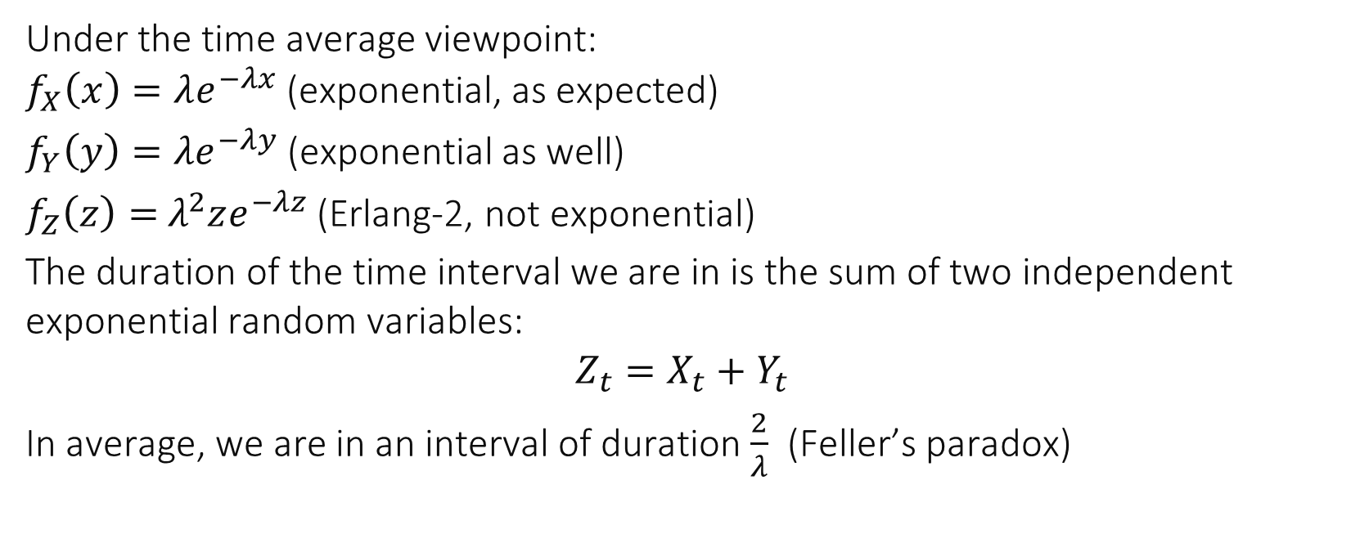
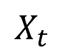
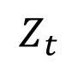
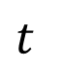
For a Poisson process…
$$Z_{t}$$
$$X_{t}$$
$$T_{n}$$
$$t$$
$$Y_{t}$$
Under the time average viewpoint: $f_{X}\left(x\right)=λe^{−λx}$ (exponential, as expected)
$f_{Y}\left(y\right)=λe^{−λy}$ (exponential as well)
$f_{Z}\left(z\right)=$ $λ^{2}ze^{−λz}$ (Erlang-2, not exponential)
The duration of the time interval we are in is the sum of two independent exponential random variables:
$$Z_{t}=X_{t}+Y_{t}$$
In average, we are in an interval of duration $\frac{2}{λ}$ (Feller’s paradox)

Slide 25
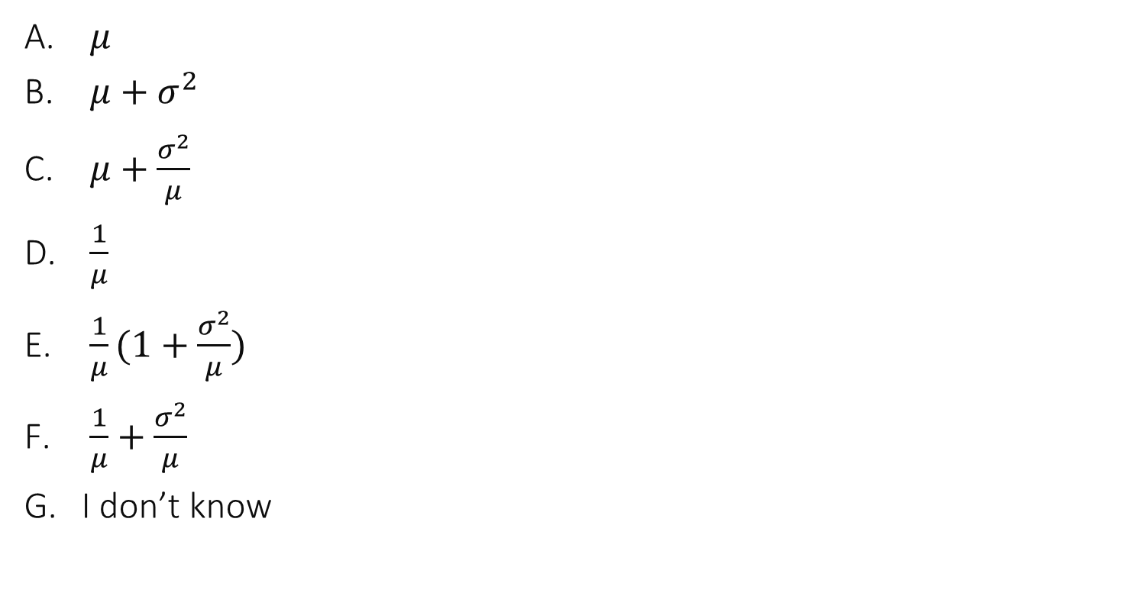

A sensor senses events; the sensing interval is $∼N(μ, σ^{2})$. An engineer comes and checks the current sensing interval. In average, she finds…
$μ$
$μ+σ^{2}$
$μ+\frac{σ^{2}}{μ}$
$\frac{1}{μ}$
$\frac{1}{μ}(1+\frac{σ^{2}}{μ})$
$\frac{1}{μ}+\frac{σ^{2}}{μ}$
I don’t know

Slide 26

Solution
By the Feller paradox formula (7-32), she finds $$E\left(Z\left(t\right)\right)=λE^{0}\left(T_{1}^{2}\right) \\ =\frac{1}{μ}×\left( μ^{2}+σ^{2}\right) \\ =μ\left(1+\frac{σ^{2}}{μ^{2}}\right)$$ Answer C
It is also the only formula where the units are OK

Slide 27


A sensor senses events; the sensing interval is $∼expo(λ)$, i.e. the event process is Poisson. An engineer comes and checks the current sensing interval. In average, she finds…
$\frac{1}{λ}$
$\frac{2}{λ}$
$\frac{1}{λ}\left(1+\frac{1}{λ}\right)$
$\frac{1}{λ}\left(1+\frac{1}{λ^{2}}\right)$
I don’t know

Slide 28

By the Feller paradox formula (7-32), she finds
$$E\left(Z\left(t\right)\right)=λE^{0}\left(T_{1}^{2}\right)=λ×\left(\frac{1}{λ^{2}}+σ^{2}\right)$$
where $σ^{2}$ is the variance of the exponential distribution, equal to $\frac{1}{λ^{2}}$. Thus
$$E\left(Z\left(t\right)\right)=\frac{2}{λ}$$
Answer B
For a Poisson process, the average duration of the time between events is $1/λ$, but the average duration of the current interval (seen by the inspector) is $2/λ$. This is Feller’s paradox. An inspector is more likely to sample a long interval than a short one.

Slide 29














2. Application to Simulation
Modulator-based simulation
Modulator: a sequence of states $Z_{n}$ (e.g. channel state) and durations $S_{n}$ stationary w.r. $n$
Modulated process: $Z\left(t\right), t∈[0,+∞)$ such that $Z\left(t\right)=Z_{n}$ whenever $\sum_{i=1}^{n−1}{S_{i}}≤t<\sum_{i=1}^{n}{S_{i}}$
State $Z(t)$
$$Z_{3}=Z(t)$$
$$Z_{4}$$
$$Z_{5}$$
$$Z_{2}$$
$$Z_{6}$$
$$Z_{1}$$
$$t$$
Time $t$
$$S_{1}$$
$$S_{2}$$
$$S_{3}$$
$$S_{4}$$

Slide 30



At $T_{n}$, channel state is drawn at random and new state is $i$ with proba $π_{i}^{0}$. When channel state $Z\left(t\right)$ is $=i$, loss proba is $p_{i}$ and residence time in that state is (non random) $r_{i}$. What is the intensity of the point process $T_{n}$?
$λ=\sum_{i}{π_{i}^{0}r_{i}}$
$λ=\sum_{i}{\frac{π_{i}^{0}}{r_{i}}}$
$λ=\frac{1}{\sum_{i}{π_{i}^{0}r_{i}}}$
None of the above
I don’t know

Slide 31

Solution
By the intensity formula, $λ^{−1}$ is the mean duration of an interval, sampled at the beginning of an interval $$λ^{−1}=E^{0}\left( T_{1}\right)=\sum_{i}{π_{i}^{0}r_{i}}$$
Answer C

Slide 32


At $T_{n}$, channel state is drawn at random and new state is $i$ with proba $π^{0}(i)$. When channel state $Z\left(t\right)$ is $=i$, loss proba is $p_{i}$ and residence time in that state is $r_{i}$. What is the loss probability $p$for a probe packet sent at an arbitrary point in time $t$?
$\frac{\sum_{i}{π_{i}^{0}p_{i}r_{i}}}{\sum_{i}{π_{i}^{0}r_{i}}}$
$\frac{\sum_{i}{π_{i}^{0}r_{i}}}{\sum_{i}{π_{i}^{0}p_{i}r_{i}}}$
$\frac{\sum_{i}{π_{i}^{0}p_{i}r_{i}}}{\sum_{i}{π_{i}^{0}p_{i}}}$
None of the above
I don't know

Slide 33

Solution
When the probe packet is sent, it finds the channel in some state $Z(t)$. The probability of loss, given the state $Z\left(t\right)=i$, is $p_{i}$. The loss probability, for the probe packet, is $$\overline{p}=P\left(loss\right)=\sum_{i}{P\left(loss | Z\left(t\right)=i\right)P\left(Z\left(t\right)=i\right)}=\sum_{i}{p_{i}P\left(Z\left(t\right)=i\right)}=E\left(p_{Z\left(t\right)}\right)$$
By the inversion formula $$E\left(p_{Z\left(t\right)}\right)=λE^{0}\left(\int_{0}^{T_{1}}{p_{Z(s)}ds}\right)=λE^{0}\left(p_{Z_{1}}T_{1}\right) \\ =λ\sum_{i}{π_{i}^{0}p_{i}r_{i}}=\frac{\sum_{i}{π_{i}^{0}p_{i}r_{i}}}{\sum_{i}{π_{i}^{0}r_{i}}}$$
Answer A

Slide 34


Is the previous simulation stationary ?
Seems like a superfluous question, however there is a difference in viewpoint between the epoch $n$ and time $t$ If there is a stationary regime, by the intensity formula:
$$λ=\frac{1}{E\left(S_{n}\right)}$$ So the expectation of $S_{n}$ must be finite. This is also sufficient:

Slide 35


RWP
Modulator: $n$th trip $Z_{n}=\left(M_{n}, M_{n+1},V_{n}\right)$
Modulated Process: $Z\left(t\right)=$ the trip that we are in at time $t$
Duration of $n$th trip $S_{n}=\frac{d(M_{n},M_{n+1})}{V_{n}}$
Assume waypoints and speed are chosen independently (as in lab) $$E\left(S_{n}\right)=E\left(d\left(M_{n},M_{n+1}\right)\right) E\left(\frac{1}{V_{n}}\right)$$
Assume speed is chosen uniformly between $v_{min}≥0$ and $v_{max}>0$
$$E\left(\frac{1}{V_{n}}\right)=\frac{1}{v_{max}−v_{min}}\int_{v_{min}}^{v_{max}}{\frac{1}{v}dv }=\frac{1}{v_{max}−v_{min}}\left(\log{v_{max}}−\log{v_{min}}\right)$$
There is a stationary regime $⇔$ $v_{min}>0$

Slide 36


Time Average Speed, Averaged over n independent mobiles
Blue line is one sample; Red line is estimate of $E(V(t))$

Slide 37


A Random waypoint model that has no stationary regime
When $v_{min}=0$ there is no stationary regime.
But this model was often used in practice --“considered harmful” [YLN03]
Simulation becomes old and “freezes” – average speed $→0$

Slide 38


Stationary Distribution of Speed (For model with stationary regime)

Slide 39



Closed Form
Assume a stationary regime exists and simulation is run long enough
Apply inversion formula and obtain distribution of instantaneous speed V(t)
$$v_{min}$$

Slide 40

A (true) example: Compare impact of mobility on a protocol: Experimenter places nodes uniformly for static case, according to random waypoint for mobile case. Concludes that static is better Find the bug !
Spatial distribution of nodes is different for mobile case than for static case
Spatial distribution of nodes is same for mobile and static cases but speed is more often small than large
There is no bug, mobility increases capacity
I don’t know

Slide 41
Solution
In the mobile case, the nodes are more often towards the center, distance between nodes is shorter, performance is better
The comparison is flawed. Should use for static case the same distribution of node location as random waypoint.
Is there such a distribution to compare against ?

Slide 42

A Fair Comparison
Revisit the comparison by sampling the static case from the stationary regime of the random waypoint
Static, same node location as RWP
Random waypoint
Static, from uniform

Slide 43


Does this model have a stationary regime ?
Yes if 𝑝>1
Yes if $p>2$
Yes for all $p$
No
I don’t know

Slide 44

Solution
The only condition is that mean trip duration be finite. The trip duration is Pareto$(p)$. It has a finite mean iff $p>1$
Answer A

Slide 45


3. Perfect Simulation
Def: a simulation that starts with a sample from the stationary distribution
An alternative to removing transients
Usually difficult except for modulated models, e.g. RWP
Perfect simulation of RWP: Sample speed $V$ from its time stationary distribution
Sample $Prev$ and $Next$ waypoints from their joint stationary distribution
Sample $M$ uniformly on segment $[Prev,Next]$

Slide 46

Stationary Distrib of Prev and Next

Slide 47

Is $M(t)$ uniformly distributed ?
Yes
No
It depends on the distribution of speed
I don’t know

Slide 48

Is $Next(t)$ uniformly distributed ?
Yes
No
It depends on the distribution of speed
I don’t know

Slide 49

Solution
The distribution of $M(t)$ is not uniform (more towards the center)
The distribution of Next$(t)$ is not uniform (more towards the corners)
The distribution of P$rev(t)$ is not uniform (more towards the corners)
The distributions of Next$(t)$ and Prev$(t)$ are the same

Slide 50

Stationary Distribution of Location Is also Obtained By Inversion Formula

Slide 51



Slide 52

No Speed Decay

Slide 53

Perfect Simulation of RWP: How do you sample the speed ?
By rejection sampling
By CDF inversion
By an ad-hoc method
I don’t know

Slide 54


Perfect Simulation of RWP: How do you sample the current segment $(P,N)$ ?
By rejection sampling
By CDF inversion
By an ad-hoc method
I don’t know

Slide 55

Perfect Simulation Algorithm
Sample a speed V(t) from the time stationary distribution by CDF inversion
Sample Prev(t), Next(t) by rejection sampling
Sample M(t) uniform on [Prev(t) ; Next(t)]

Slide 56

4. PASTA“Poisson Arrivals See Time Averages”
More exactly: Poisson Arrivals independent of simulation state See Time Averages.
System modeled as a Markov chain $S\left(t\right)∈𝒮$, stationary. Selected transitions (events of interest) $ℱ_{0}⊂𝒮×𝒮$, $C_{i,j}=$ rate of transition $i→j$ when $\left(i,j\right)∈ℱ_{0}$.
Hypothesis: $\sum_{j}{C_{i,j}}$ is independent of $i$.
Example: M/M/1 queue $𝒮=ℕ$; $ℱ_{0}=$“arrivals” $=\{\left(n,n+1\right), n≥0\}$, $C_{n,n+1}=λ, C_{n,n^{′}}=0$ if $n^{′}≠n$. Here $\sum_{j}{C_{n,j}}=λ$, independent of system state $n$ i.e. arrivals are independent of system state.
E.g. an observer that arrives according to a Poisson process of any rate, independent of system state, see the stationary distribution ( = at an arbitrary point in time).

Slide 57



Consider an M/M/1 queue with $ρ<1$. Does the point process of departures satisfy PASTA ?
No
Yes
It depends on the parameters
I don’t know
Service : Exponential $μ$
Arrival : Poisson $λ$
FIFO queue, 1 server

Slide 58

Solution
The state just before a departure satisfies $N≥1$ where $N$ is the number of customers, therefore we never see $N=0$ just before a departure.
In contrast, for an observer, i.e. under the stationary probability, we see $N=0$ with probability $1−ρ>0$
PASTA does not hold, answer A.
Service : Exponential $μ$
Arrival : Poisson $λ$
FIFO queue, 1 server

Slide 59

We can also see that the assumptions of PASTA do not hold: System state : $N\left(t\right)=$ number of customers in system
Given that $N\left(t\right)=n>0$ the probability of a departure in $\left[t, t+dt\right]$ is $μ dt+o(dt)$ i.e. rate of event “departure” is $μ$ $C_{n,n−1}=μ$ and $\sum_{j}{C_{n,j}=μ}$when $n>0$
Given that $N\left(t\right)=0$ the probability of a departure in $\left[t, t+dt\right]$ is $0+o(dt)$ i.e. rate of event “departure” is $0$ $\sum_{j}{C_{n,j}=0} \text{when} n>0$
Rate of departure depends on system state $⇒$ PASTA hypothesis not satisfied.
Service : Exponential $μ$
Arrival : Poisson $λ$
FIFO queue, 1 server

Slide 60

Still, the departure process is Poisson when the queue is in its stationary regime. One possible proof is to observe that the process is reversible .
A Markov process is reversible (Eq. 8.012) if the stationary probability $π$ satisfies $π_{i}Q_{i,j}=π_{j}Q_{j,i}$ where $Q_{i,j}$ is the rate of transition from state $i$ to $j$. In general, the state is very complex (it is the state of the simulator) but for an M/M/1 queue it is equal to the number of customers (because arrivals and services are memoryless). A reversible process has the same stationary distribution when time is reversed.
For the M/M/1 queue the stationary probability is $π_{n}=ρ^{n}\left(1−ρ\right)$ with $ρ=λ/μ$ for $n∈ℕ$. Also $Q_{n,n+1}=λ$, $Q_{n,n−1}=μ1_{n>0}$ and $Q_{i,j}=0$otherwise. Thus $π_{i}Q_{i,j}=π_{j}Q_{j,i}$ for all $i,j$ and reversibility holds.
Since the arrival process is Poisson, the departure process (which becomes the arrival process when time is reversed) is also Poisson.

Slide 61



The departure Process from the M/M/1 queue is Poisson. Its rate is
$λ$
$μ$
Some other quantity
I don’t know
Service : Exponential $μ$
Arrival : Poisson $λ$
FIFO queue, 1 server

Slide 62

In stationary regime, the arrival rate is equal to the departure rate, hence $λ$.
Answer A.
We can check this numerically. The rate of departure given that the state is $n$is $μ1_{n>0}$ hence the rate of departure is
$$\sum_{n=1}^{+∞}{μ}π_{n}=μ\sum_{n=1}^{+∞}{π_{n}}=μ\left(1−π_{0}\right)=μρ=λ$$
where $ρ=\frac{λ}{μ}$ and $π_{0}=1−ρ$ (utilization law).

Slide 63


Consider an M/M/1/K queue with $ρ<1$. Does the point process of arrivals satisfy PASTA ?
No
Yes
It depends on the parameters
I don’t know

Slide 64
Solution
The arrival process is Poisson and independent of system state, therefore PASTA holds. Answer B

Slide 65

In an M/M/1/K queue, the probability that an arriving job is discarded is…
$ℙ\left(N=K\right)$
$ℙ\left(N=K−1\right)$
$ℙ\left(N=K+1\right)$
None of the above
I don’t know

Slide 66

Solution
By the PASTA property, an arriving customer sees the stationary distribution

Slide 67
Application
Observing a system according to a Poisson process, independent of the system, provides an unbiased estimate of the distribution “at an arbitrary point in time”.
Avoids aliasing issue due to periodic probing.

Slide 68

Conclusions
A metric should specify the sampling method -- different sampling methods may give very different values
Palm calculus contains a few important formulas
Freezing simulations are a pattern to be aware of
Perfect simulation is when we are able to draw from stationary distribution at $t=0$
A Poisson observer independent of system state sees time averages

